Slide 1
Unit 203: Electrical installations technology
Earthing systems

Slide 2
Earthing systems
The three main reasons for earthing electrical systems are as follows:
to maintain the potential of any part of the system at a defined value with respect to earth
to allow current to flow to earth in the event of a fault, so that the protective equipment will operate to isolate the faulty circuit
to ensure that, in the event of a fault, apparatus normally ‘dead’ cannot reach a dangerous potential with respect to earth (earth is normally taken as 0 volts, ‘no volts’).

Slide 3
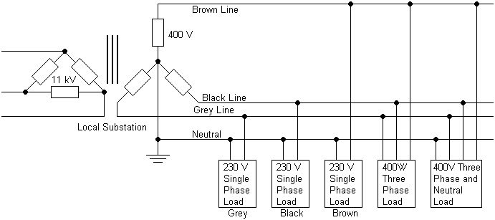
Earthing systems

Slide 4
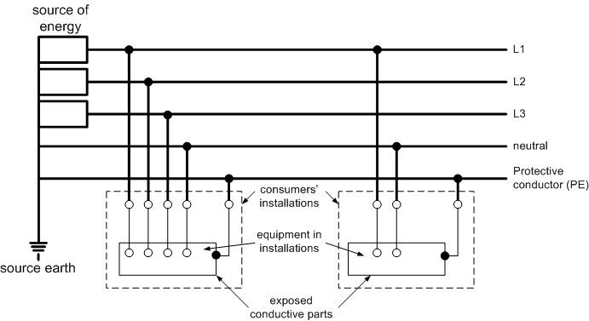
Earthing systems
TN-S system

Slide 5
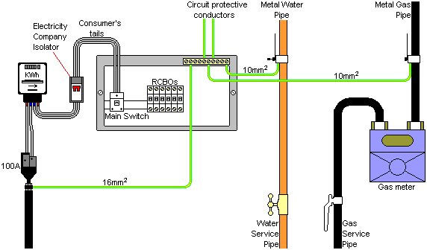
Earthing systems
TN-S system

Slide 6
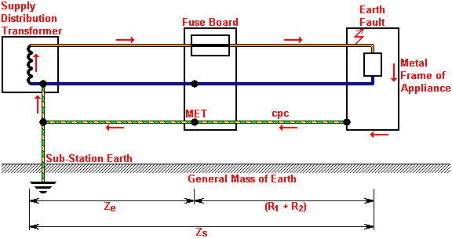
Earth loop impedance
TN-S system

Slide 7
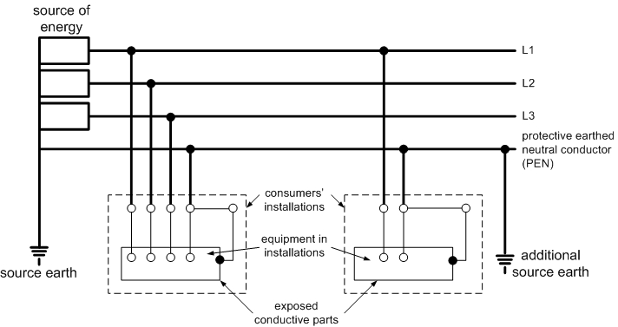
Earthing systems
TN-C-S system

Slide 8
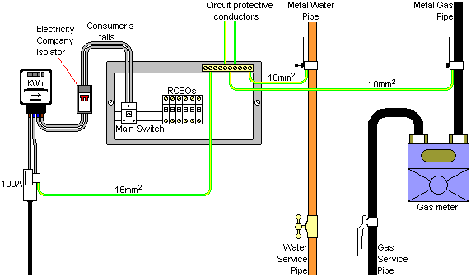
Earthing systems
TN-C-S system

Slide 9
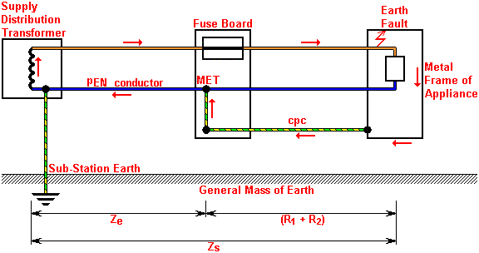
Earth loop impedance
TN-C-S system

Slide 10
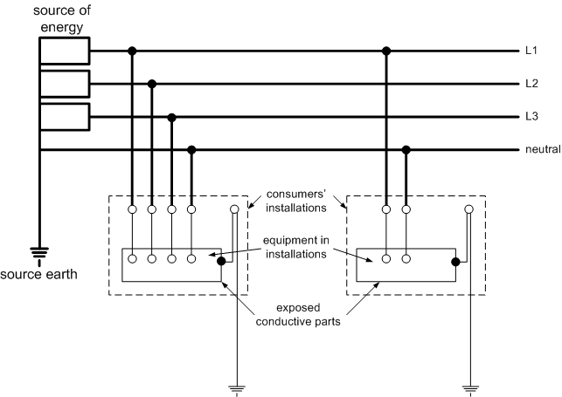
Earthing systems
TT

Slide 11
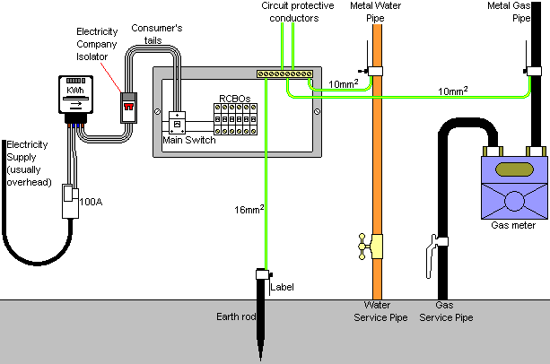
Earthing systems
TT

Slide 12
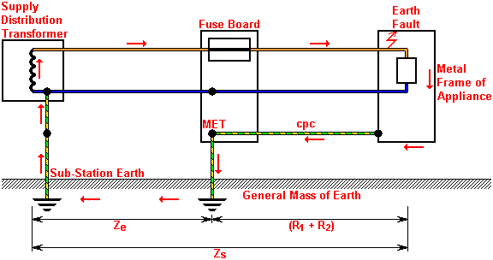
Earth loop impedance
TT system

Slide 13
Unit 203: Electrical installations technology
The End

